Slide 1
BIRD SOUND CLASSIFICATION
PRESENTED by
Aneeta L R
Under the guidance of
Prof. Nisha Markose

Slide 2
INTRODUCTION
Audio based Bird species classification
By recognizing birds researches and scientists can monitor wildlife and study the behavior of birds
Identification of birds is a difficult process because its difficult to find the birds or take photograph them.
But it is easy to record their sound.
Every species of birds has their unique sounds.
They use songs of varying length and complexity to attract mates, warn other birds of nearby danger, and mark their territory.
The proposed system helps in identifying birds based on their sound.

Slide 3
LITERATURE REVIEW
Paper | Author | Published on | Source | Summary
Deep learning-based automatic bird species identification from isolated recordings | Noumida A, Rajeev Rajan | 2021 | IEEE Xplore | Comparison between ResNet50(96.3%), CNN(93.7%), MFCC-DNN(87.7%), InceptionResNetV2(87%) and VGG-16(91.9%) Ten species with 1078 audio tracks from xeno-canto. The challenge with automatic audio recordings is detecting the calls of interest species in lengthy recordings
Classification of Bird Sound Using High-and Low-Complexity Convolutional Neural Networks | Aymen Saad, Javed Ahmed, Ahmed Elaraby | 2022 | Research Gate | Comparison between ResNet-50 and MobileNetV1 Short-Time Fourier Transform (STFT) and Mel Frequency Cepstral Coefficient (MFCC) algorithms MobileNet-v1(STFT) - 71.57%, MobileNet-v1 (MFCC) - 85.73%, ResNet-50 (STFT) - 90.40% and ResNet-50 (MFCC) - 90.56%
Design of Bird Sound Recognition Model Based on Lightweight | Fan Yang, Ying Jiang, and Yue Xu | 2022 | IEEE Xplore | ResNet50, DenseNet, VGG, MobileNet, ShuffleNet, EfficientNet and custom MobileNet(proposed) ResNet50 has more accuracy than the paper proposed architecture but proposed architecture is less costly. ResNet50(97%), proposed(95%)

Slide 4
SYSTEM ANALYSIS

Slide 5
Dataset
Source - https://www.kaggle.com/datasets/rohanrao/xeno-canto-bird-recordings-extended-a-m
This dataset contains sound recordings of 264 species.
It contains 14.7K audio files in total.
These are mp3 files.
From this dataset only 5 species were selected - Blue Jay, Black-capped Chickadee, Mallard, Common Tern and American Redstart.
Audio files are having 5 sec or more duration.
The number of files selected as data all together is 1250.

Slide 6
Data Pre-processing
Audios in dataset are trimmed to a length of 10 sec or less to make it somewhat similar.
The main purpose of this is to make sure that each bandwidth or frequency line of the audios are clearer for feature extraction.
They are converted to Mel-spectrogram.
Mel-spectrogram is an image having extension PNG.
The image is having Width x Height x Depth - 432 x 432 x 3.
4500 png images are got after conversion.

Slide 7
Architecture
Resnet50 is a convolutional neural network that is 50 layers deep.
48 convolutional layers, one MaxPool layer, and one average pool layer.
Input image size of 224 X 224.
It is composed of multiple residual blocks, each of which contains a shortcut connection that allows the network.
Shortcut connection are those skipping one or more layers.
These shortcut connections help to mitigate the vanishing gradient problem.
They helps to attain early convergence of models.
They use bottleneck design to increase the performance of the network.

Slide 8
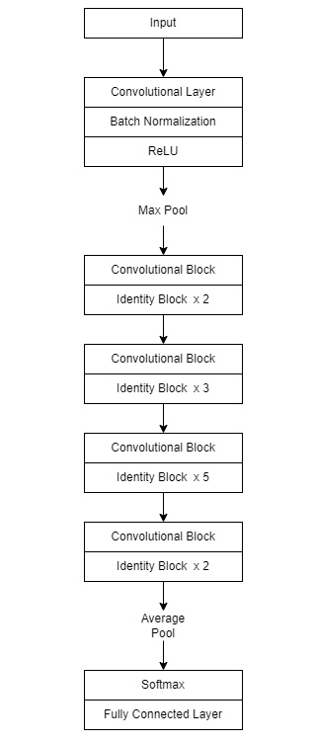

Slide 9
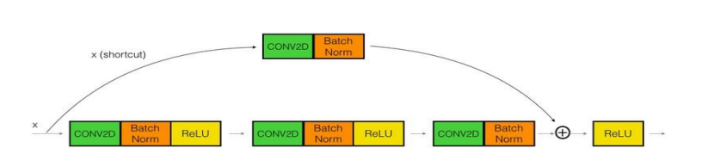
Convolutional block

Slide 10
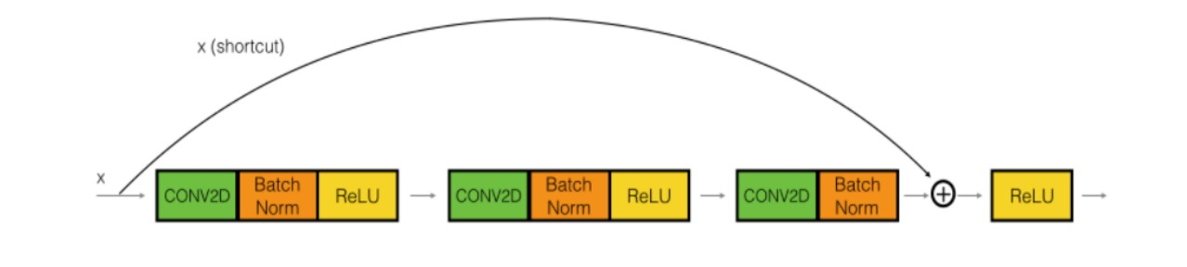
Identity block

Slide 11
Dimension Table
Layer | Kernel size | Filters | Padding | Stride | Output size | Activation function
Input | - | - | - | - | 224 x 224 | -
Conv1 | 7 x 7 | 64 | 3 x 3 | 2 | 112 x 112 | ReLU
Maxpool | 3 x 3 | - | 1 x 1 | 2 | - | -
Conv2_x | 1 x 1 3 x 3 x 3 1 x 1 | 64 64 x 3 256 | 1 x 1 | 1 | 56 x 56 | ReLU
Conv3_x | 1 x 1 3 x 3 x 4 1 x 1 | 128 128 x 4 512 | 1 x 1 | 1 | 28 x 28 | ReLU
Conv4_x | 1 x 1 3 x 3 x 6 1 x 1 | 256 256 x 6 1024 | 1 x 1 | 1 | 14 x 14 | ReLU
Conv5_x | 1 x 1 3 x 3 x 3 1 x 1 | 512 512 x 3 2048 | 1 x 1 | 1 | 7 x 7 | ReLU
Average pool | - | - | - | 2 | - | -
FC | - | - | - | - | 5 | Softmax

Slide 12
Project pipeline
• Development pipeline

Slide 13
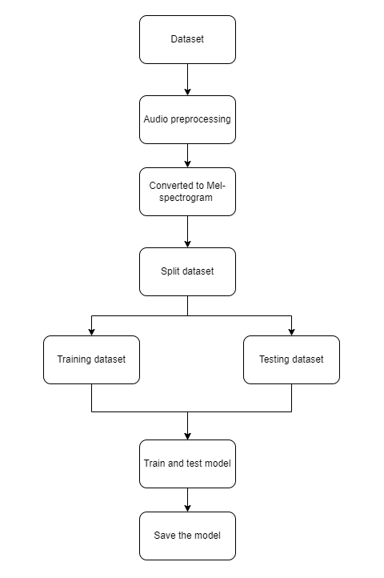

Slide 14
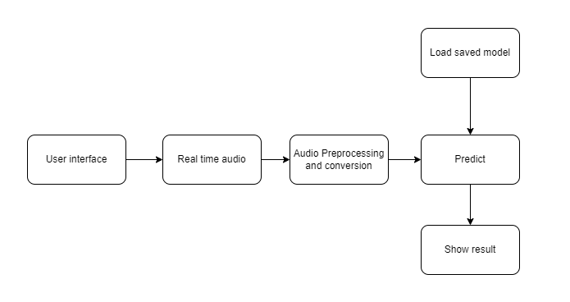
• Deployment pipeline

Slide 15
System Environment
Software Environment
Python - NumPy, Matplotlib, Tensorflow, Keras, Scikit-learn, OS
Google Colab
Kaggle
Visual Studio Code
HTML, CSS and Bootstrap
Github
Hardware Environment
Processor : Intel Core i5 preferred
Memory : 8 GB RAM or greater
Disk space : 40 GB or good internet connectivity
GPU : Nvidia K80 (Kaggle)

Slide 16
SYSTEM DESIGN

Slide 17
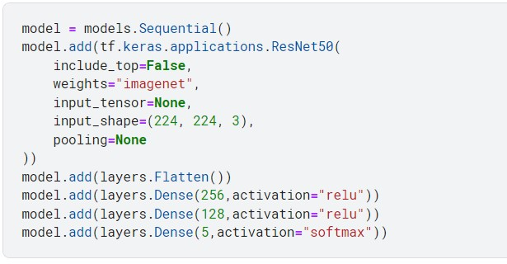
Implementation Code

Slide 18
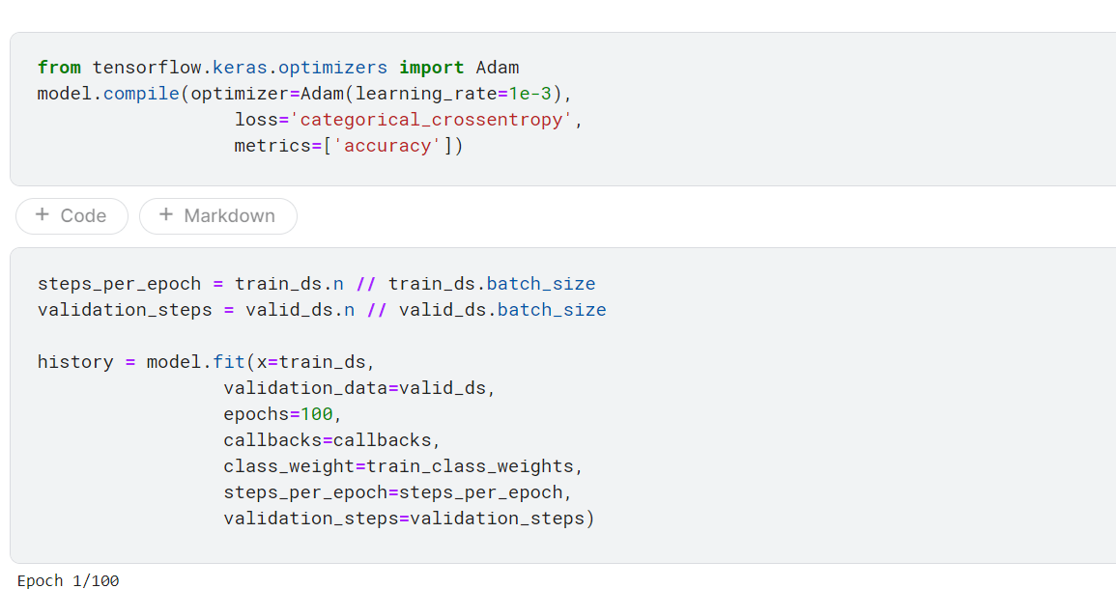
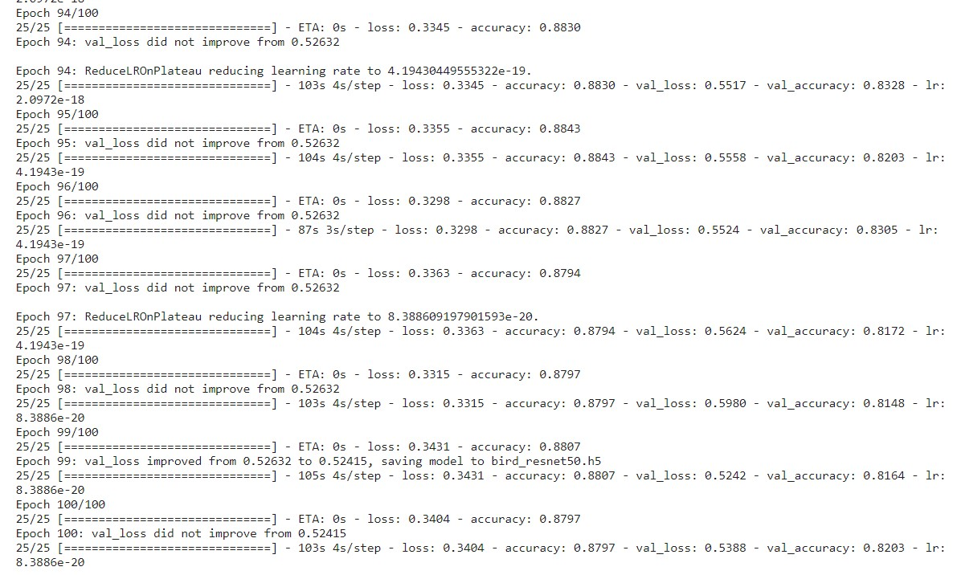
Training

Slide 19
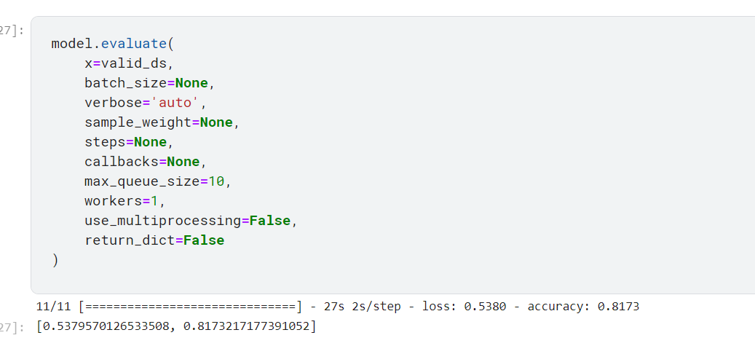
Model evaluation

Slide 20
RESULTS AND DISCUSSION

Slide 21
The aim of this project was to build a system which helps to identify if the bird is Blue Jay, Black-capped Chickadee, Mallard, Common Tern or American Redstart by their sound.
The project use Resnet50 architecture to build the model.
Training accuracy - 88.07%
Validation accuracy - 81.64%
Test accuracy - 81.73%
Training loss - 0.3431
Validation loss - 0.5242

Slide 22
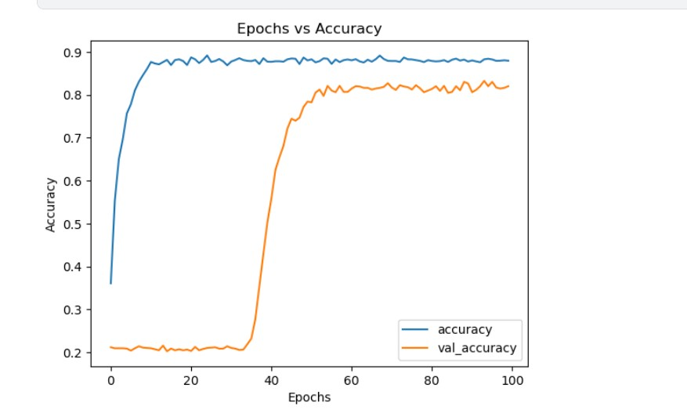
Accuracy graph

Slide 23
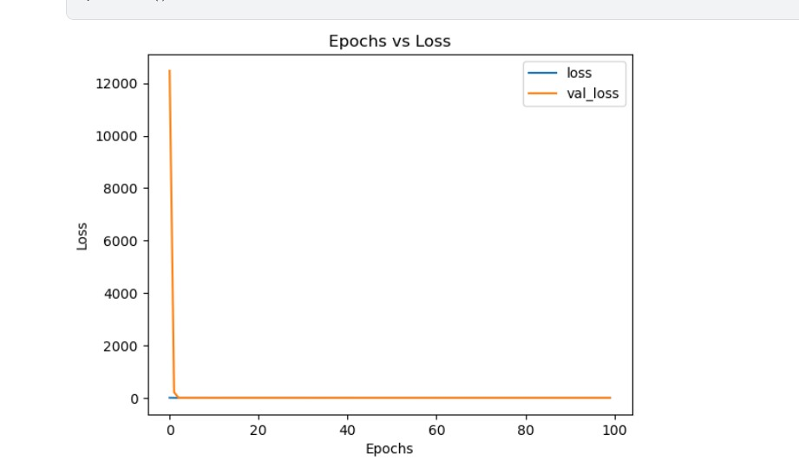
Loss graph

Slide 24
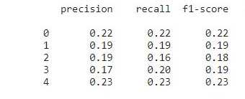
Classification report

Slide 25
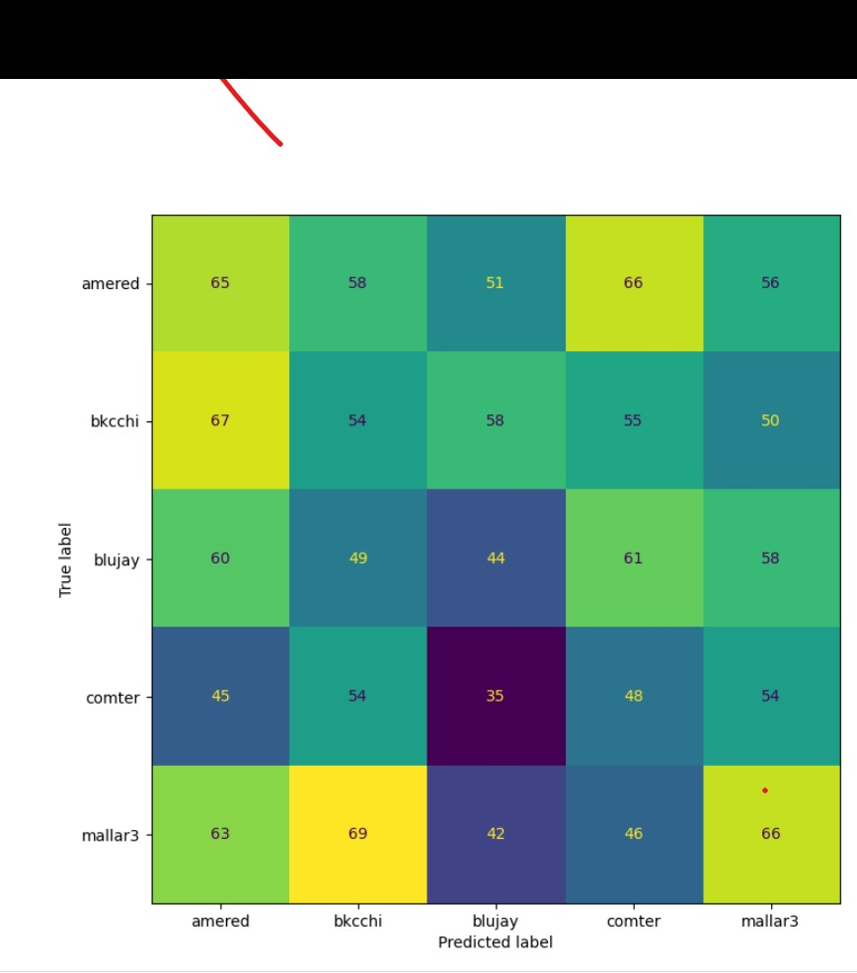
Confusion matrix

Slide 26
FUTURE SCOPE
Expand the scope of these systems to include a wider variety of birds.
Develop real-time systems that can identify birds in the wild as they call rather than pre-recorded audio.
Upgrade where audio is extracted from a video and use that audio to identify.

Slide 27
Thank you

